Slide 1

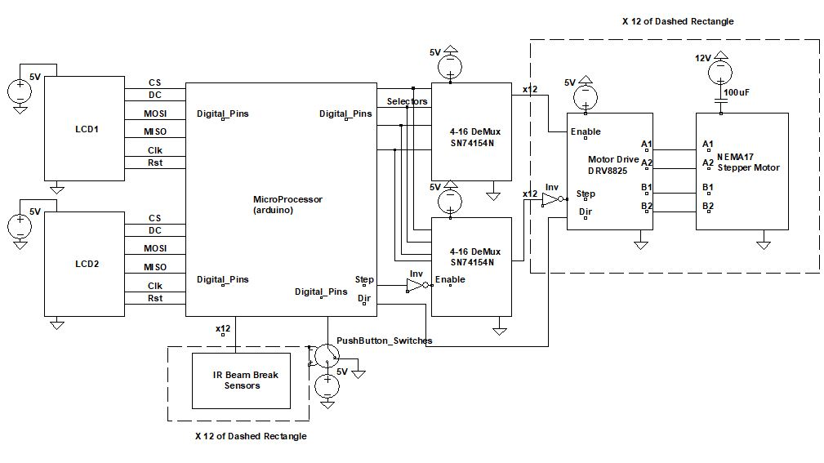


Senior Design Expo 2018
Description
Flow Chart
bPong is an automatic “pong” table, recreating the nationally popular game of Beer Pong and implementing a series of improvements to the game experience via automation. The table has two LCD screens, such that each team can easily interact with the board throughout the game. Once a game is started, 12 cups automatically rise to the surface of the table, and once a ball is fairly scored into a cup, the cup is automatically lowered beneath the table. Scores deemed unfair can be undone, and the game state resets on the end of a game. Players can opt to “rerack” the cups during the course of the game.
Start Game
Begin Turn
Rerack
Player Shoot
Undo
Miss
Score
If no cup is left
End Turn
End Game
Circuit Schematic
Future Improvements
Elbow Detection
Liquid Pump for Punishment/Reward
Embedded LED on Table
Autonomous Ball Projector for 1 Player Mode
Better microprocessor
Improve GUI

